Slide 1
EXHIBITORS MANUAL
General Information
This manual is designed to ensure that your participation is smooth and a seamless process.
Please go through it carefully and read .
Contact us on: +260 211 296 142 or Cell 0972 989 009
Email: sales@poshzambia.com
Email: suzyo@poshzambia.com
Please note all the deadlines listed.

Slide 2
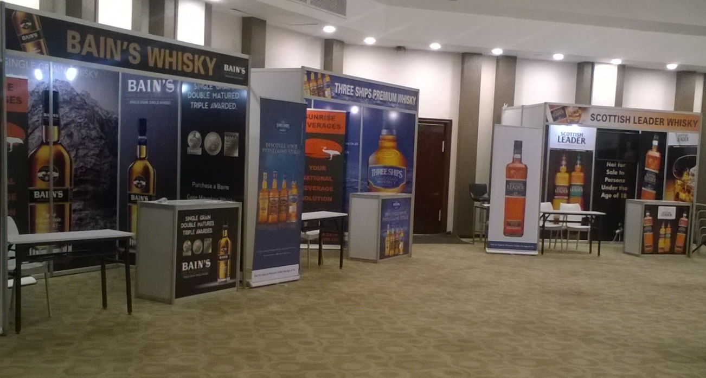
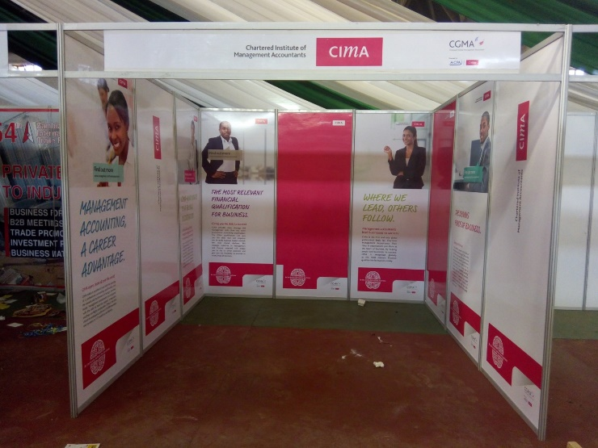
Exhibition Booth –Shell Scheme
3x3 Branded Shell Scheme Booth
(2 chairs, 1 trestle table, 2 spot lights, 1 power point)
NB. Excluding the straight counter
Standard 3m x 3m branded or unbranded Shell Scheme Booth
( 2 chairs, 1 trestle table, 2 spot lights & 1 power point)

Slide 3
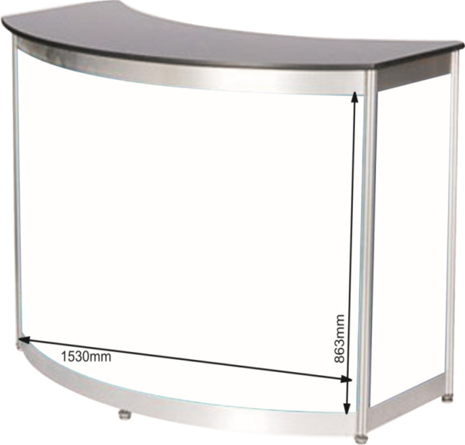
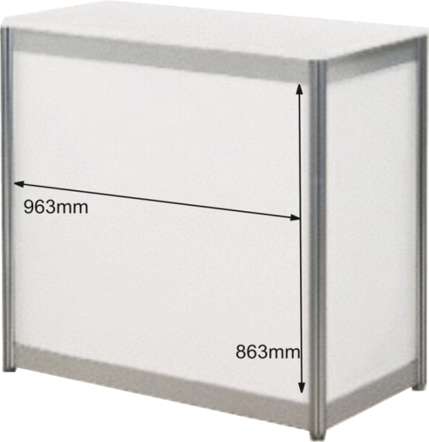
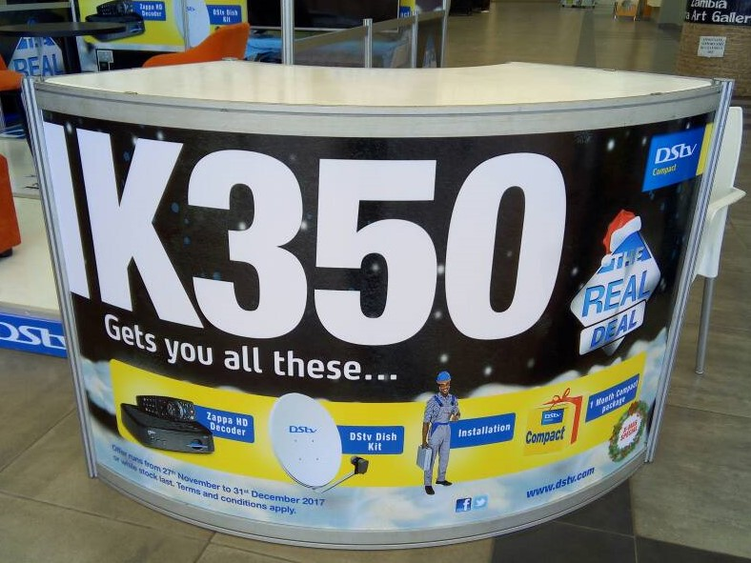
Curved Counter
Straight Counter (unbranded)
Curved Counter (branded)

Slide 4
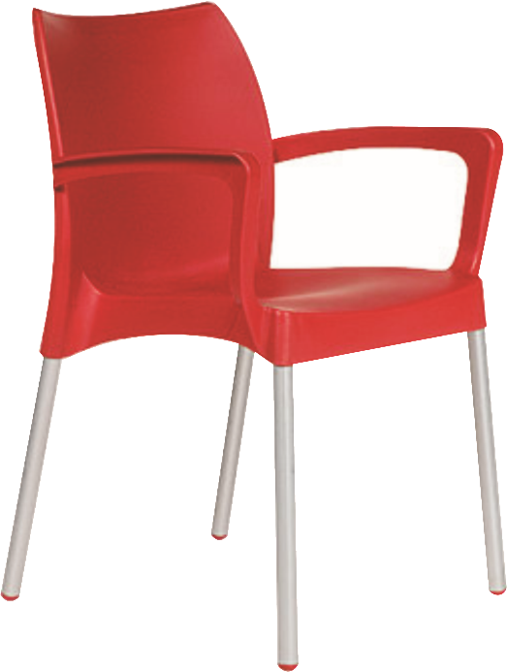
Designer chairs available in
Black, Green, Orange White
Designer Bar Stools
Black, Red, Orange, White
Tub Chair

Slide 5
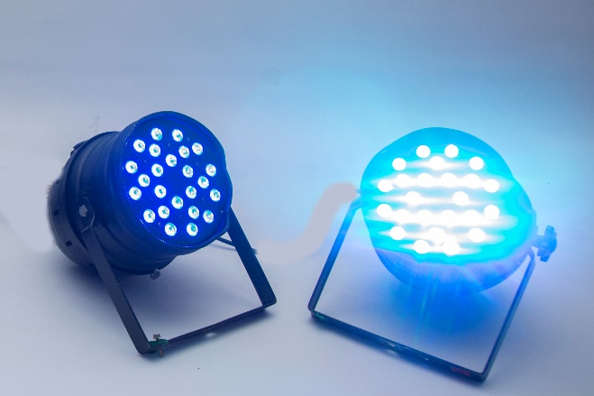
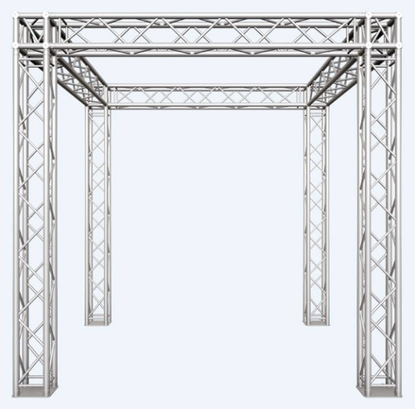
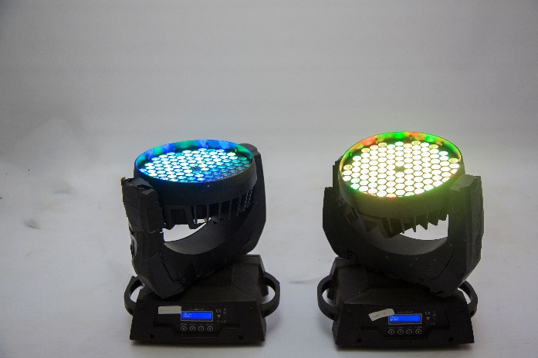
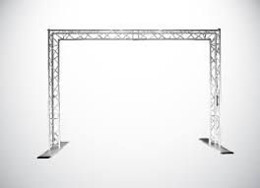
Parcans
Trussing Charge determined by size required

Slide 6
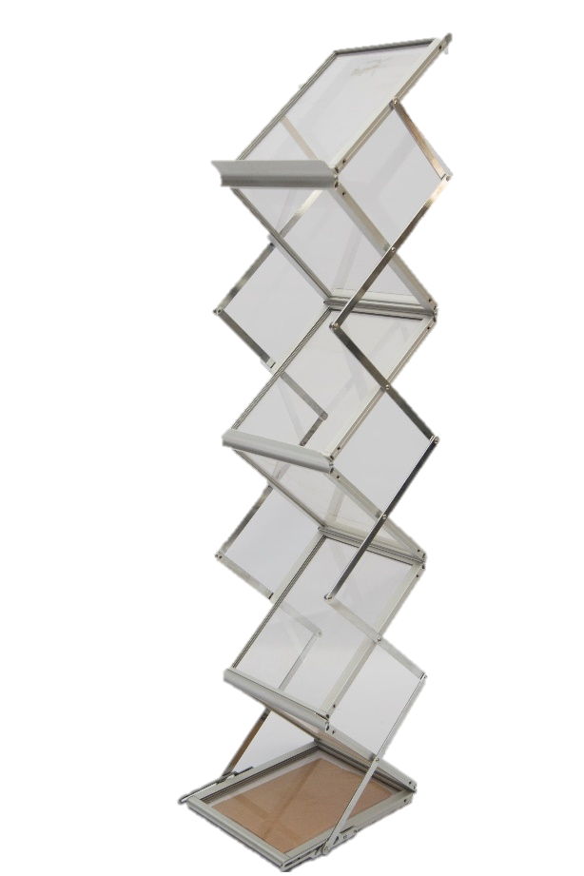
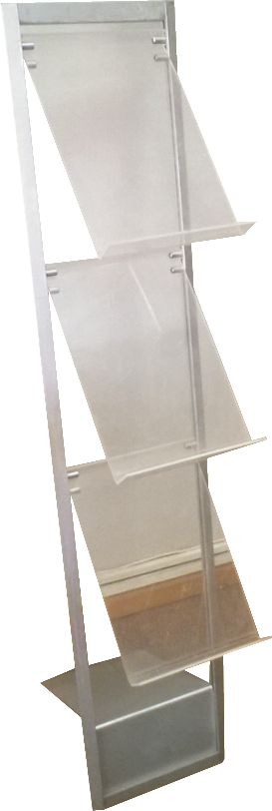
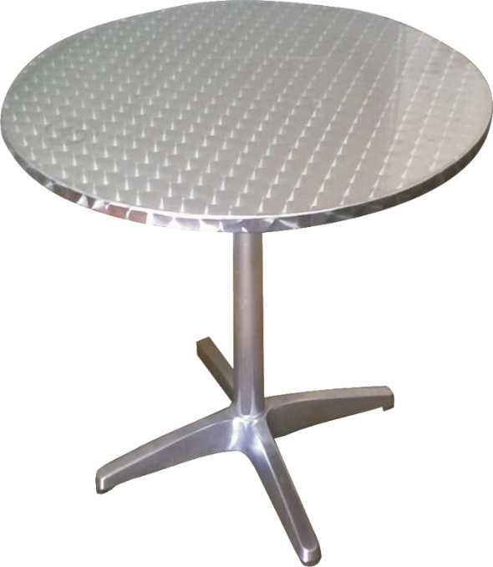
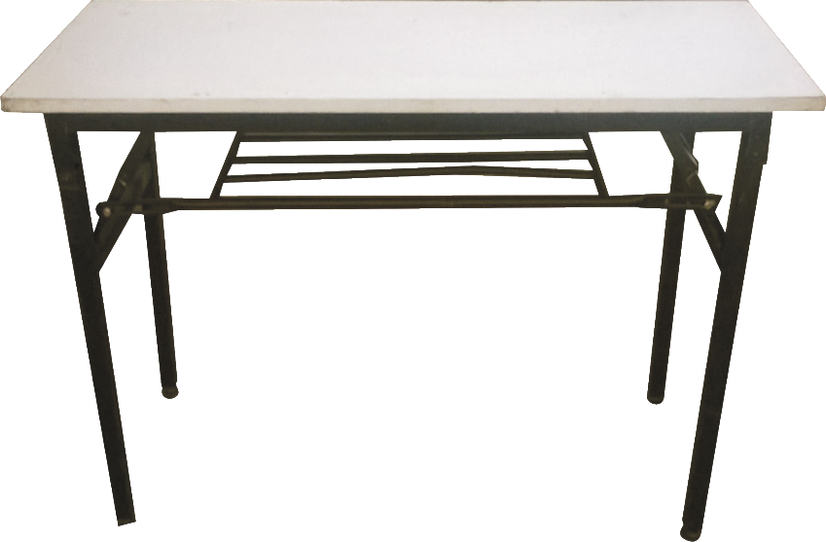
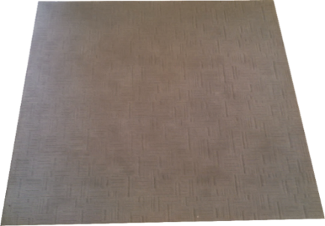
Café tables
Brochure rack (Basic)
Brochure rack
(Perspex)
Metallic Bin
Trestle Table
(1.80 X 0.75M
Carpet Tile - Light grey
500mm x 500mm
Carpet Tile - Dark grey
1m x 1m

Slide 7
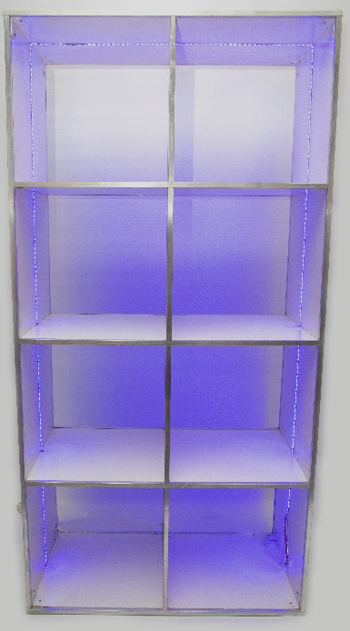
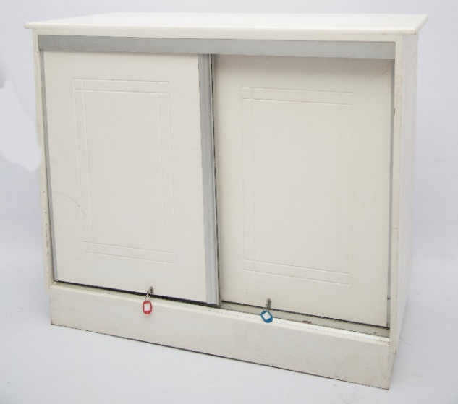
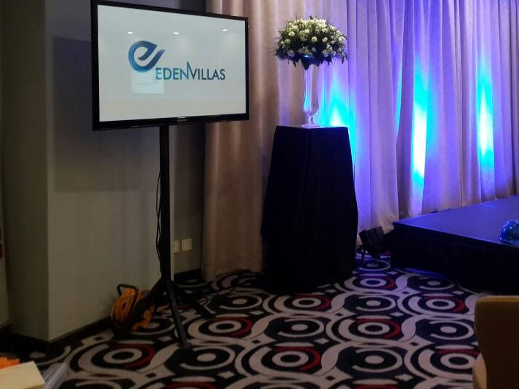
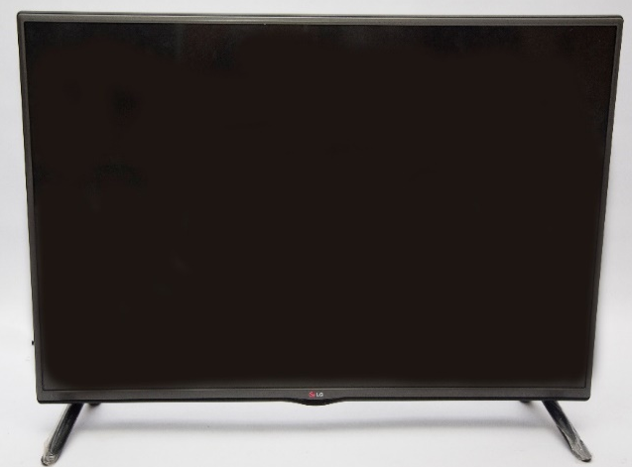
Lockable Straight Counter
Bar Shelves
51-55 inch TV & Stand VGA,HDMI & AV connections
Wooden Display Stand
TV & Stand

Slide 8
Exhibitors are asked to not exceed the exhibition space that has been booked by their organization.
Exhibitors are not permitted to start dismantling the stands nor leave their stands before end of conference.
Dismantling will take place after the last day of exhibition.
IMPORTANT DATES
Artwork Submission- Deadline Date – 2 weeks before conference start date
Final Orders -Deadline Date – 1 week before conference start date
Set Up Date : 48 hours before conference start date
Exhibition Date: TBA
ORDERS
Confirmation of an order must be in writing and signed by authorized personnel.
50% payment must be made in order to secure stock.
100% payment must be made within 30days of completion. Late payments attract interest rates as per quote provided.
All payments must be made to Posh Media Ltd.
Late order confirmation may result in a delayed service.
ARTWORK SUBMISSION
All artwork must be delivered in high resolution
If design work is to be done by Posh Media it attracts a charge and deliver artwork 30 days prior to exhibition date.
Artwork can be delivered through USB, Email, CD.
Artwork to be delivered in the following formats; .tiff / hi res.jpeg / pdf / Corel draw.
The size of each panel is height 240cm and width 97cm. A complete 3m by 3m booth has 9 panels to brand. A 3m x 2m booth has 7 panels to brand.
Facia Plate Height 36cm x 3m length.

